Slide 1
CS 2212
Introduction to Software Engineering
Chapter 19 Software Testing Component Level

Slide 2
Copyright Notice This Presentation and Its Associated Video Contain Copyright Material. This Presentation and Its Associated Video Are Provided for Teaching Purposes of CS2212 and Should Not Be Posted In Any External Site, Or Shared with. This Presentation and Its Associated Video Are Provided For Instructional Personal Use Only, and Only For The Purposes of the CS2212 Course.

Slide 3
Part 52
Software Testing Concepts, Strategies, and Activities
Regardless of your plans, production is the ultimate testing environment.
― JT Wall.
Notes:
This lesson introduces the basic steps in a software engineering project at a high level.
In practice, steps often overlap.

Slide 4
Learning Objectives in this Part
To understand the concept of software testing, its process, and its activities

Slide 5
Program testing
Can reveal the presence of errors NOT their absence
Only exhaustive testing can show a program is free from defects. However, exhaustive testing for any but trivial programs is impossible
A successful test is a test which discovers one or more errors
Should be used in conjunction with static verification
Run all tests after modifying a system

Slide 6
Some Terminology
fault, bug, error,
defect
It is there in the program…
Fault
Program state
Error
Observed
Failure

Slide 7
Testing in the V-Model
Requirements
Acceptance
test
Customer
Developer
Architectural
Design
System test
Run tests
Write tests
Detailed
Design
Integration test
Functional
(BB)
Structural
(WB)
Module
implementation
Unit test

Slide 8
Testing Activities
Requirements
Analysis
Document
Subsystem
Code
Unit
Requirements
Analysis
Document
System
Design
Document
T
est
Tested
Subsystem
User
Manual
Subsystem
Code
Unit
T
est
Tested
Subsystem
Integration
Functional
Test
Test
Integrated
Subsystems
Functioning
System
Tested Subsystem
Subsystem
Code
Unit
T
est
All tests by developer

Slide 9
Testing Activities continued
Client’s
Understanding
of Requirements
Global
Requirements
User
Environment
Functioning
System
Validated
System
Accepted
System
Performance
Acceptance
Installation
Test
Test
Test
Usable
System
Tests by client
Tests by developer
User’s understanding
System in
Use
Tests (?) by user

Slide 10
Testing and debugging
Defect testing and debugging are different processes
Defect testing is concerned with subjecting the system to selected input in order to confirm the presence of errors (bugs)
Debugging is concerned with locating and repairing the errors found during defect testing
The debugging process is an investigative activity which starts by formulating an hypothesis about the root cause and proceeds by systematically evaluating these hypotheses in order to locate the error

Slide 11
Defect Testing Activities
Identify
Test conditions (“What”): an item or event to be verified.
How the “what” can be tested: realization
Design
Build test cases (imp. scripts, data)
Build
Run the system
Execute
Test case outcome with
expected outcome
Compare
Test result

Slide 12
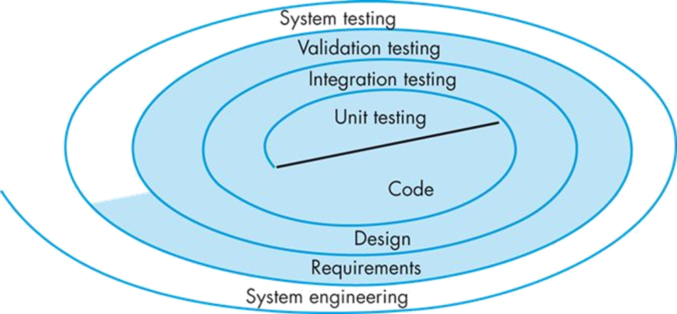
Defect Testing Strategy
The software process may be viewed as a spiral:
Initially, system engineering defines the role of software and leads to software requirements analysis, followed by design and finally coding
As software is developed, you spiral inward along streamlines that decrease the level of abstraction on each turn
A strategy for software testing may also be viewed in this context:
Unit testing begins at the vortex of the spiral, followed by integration testing, validation testing, and finally system testing
To test software, you spiral out along streamlines that broaden the scope of testing with each turn

Slide 13
Goodness of test cases
Exec. of a test case against a program P
Covers certain requirements of P;
Covers certain parts of P’s functionality;
Covers certain parts of P’s internal logic.
➔ Idea of coverage guides test case selection.

Slide 14
Black-box Testing
Focus: I/O behavior. If for any given input, we can predict the output, then the module passes the test.
Almost always impossible to generate all possible inputs ("test cases")
Goal: Reduce number of test cases by equivalence partitioning:
Divide input conditions into equivalence classes
Choose test cases for each equivalence class. (Example: If an object is supposed to accept a negative number, testing one negative number is enough)

Slide 15
White-box Testing
Statement Testing (Algebraic Testing): Test single statements
Loop Testing:
Cause execution of the loop to be skipped completely. (Exception: Repeat loops)
Loop to be executed exactly once
Loop to be executed more than once
Branch Testing (Conditional Testing): Make sure that each possible outcome from a condition is tested at least once
Example:
if(i == TRUE)
print (“Yes”)
else
print(“No”)
Path testing:
Make sure all paths in the program’s flow of control are executed
Test cases: 1) i = TRUE
2) i = FALSE

Slide 16
White-box Testing: Determining the Basic Blocks
FindMean (FILE ScoreFile)
{ float SumOfScores = 0.0;
int NumberOfScores = 0;
float Mean=0.0; float Score;
Read(ScoreFile, Score);
while (! EOF(ScoreFile) {
if (Score > 0.0 ) {
SumOfScores = SumOfScores + Score;
NumberOfScores++;
}
Read(ScoreFile, Score);
}
/* Compute the mean and print the result */
if (NumberOfScores > 0) {
Mean = SumOfScores / NumberOfScores;
printf(“ The mean score is %f\n”, Mean);
} else
printf (“No scores found in file\n”);
}
1
2
3
4
5
6
7
8
9

Slide 17
Constructing the Logic Flow Diagram

Slide 18
Branch Coverage C1
1
2
P1
T F
Here a T,T and
F,F combination will
suffice to have Branch
coverage (Predicate
coverage C1)
P2
T F

Slide 19
Path Coverage Testing C₁P
This is the same as the C₁ but now we must consider test cases that exercise all all possible outcomes of the choices T,T, T,F, F,T, F,F for the predicates P1, and P2 respectively, in the Control Flow graph.
P1
T F
P2
T F

Slide 20
Comparison of White & Black-box Testing
White-box Testing:
Potentially infinite number of paths have to be tested
White-box testing often tests what is done, instead of what should be done
Cannot detect missing use cases
Black-box Testing:
Potential combinatorical explosion of test cases (valid & invalid data)
Often not clear whether the selected test cases uncover a particular error
Does not discover extraneous use cases ("features")
Both types of testing are needed
White-box testing and black box testing are the extreme ends of a testing continuum.
Any choice of test case lies in between and depends on the following:
Number of possible logical paths
Nature of input data
Amount of computation
Complexity of algorithms and data structures

Slide 21
The 4 Testing Steps
1. Select what has to be measured
Analysis: Completeness of requirements
Design: tested for cohesion
Implementation: Code tests
2. Decide how the testing is done
Code inspection
Proofs (Design by Contract)
Black-box, white box,
Select integration testing strategy (big bang, bottom up, top down, sandwich)
3. Develop test cases
A test case is a set of test data or situations that will be used to exercise the unit (code, module, system) being tested or about the attribute being measured
4. Create the test oracle
An oracle contains of the predicted results for a set of test cases
The test oracle has to be written down before the actual testing takes place

Slide 22
Guidance for Test Case Selection
Use analysis knowledge about functional requirements (black-box testing):
Use cases
Expected input data
Invalid input data
Use design knowledge about system structure, algorithms, data structures (white-box testing):
Control structures
Test branches, loops, ...
Data structures
Test records fields, arrays, ...
Use implementation knowledge about algorithms:
Examples:
Force division by zero
Use sequence of test cases for interrupt handler

Slide 23
Part 53
Component level Software Testing (Unit Testing)
The most secure code in the world is code which is never written.
― Colin Percival.
Notes:
This lesson introduces the basic steps in a software engineering project at a high level.
In practice, steps often overlap.

Slide 24
Learning Objectives in this Part
To learn about unit testing

Slide 25
Unit Testing
Unit testing focuses verification effort on the smallest unit of software design – the software component, module, or class
In unit testing, testers assess the unit under testing by subjecting it to a number of test cases and inspecting the results to see if the unit is operating according to expectations
The relative complexity of tests and the errors those tests uncover is limited by the constrained scope established for user testing
The unit test focuses on the internal processing logic and data structures of the unit
This type of testing can be conducted in parallel for multiple components

Slide 26
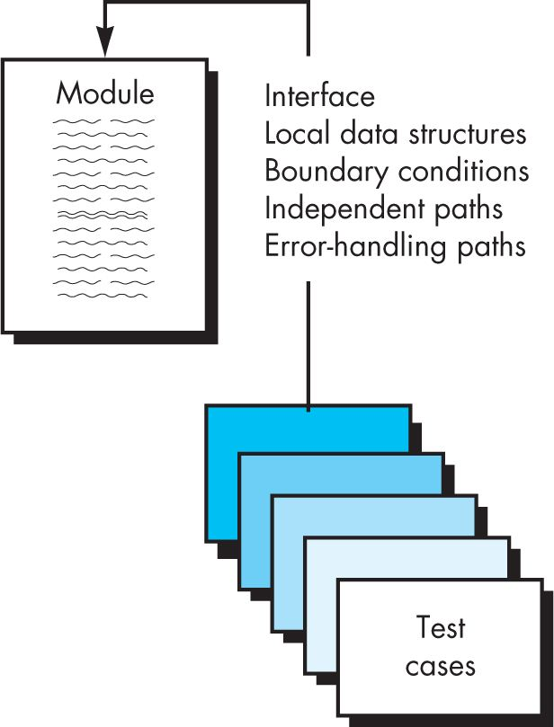
Unit Testing

Slide 27
Unit Testing
Interface testing
The module interface is tested to ensure that information properly flows into and out of the program unit under test
If data cannot enter and exit properly, all other tests are moot
Local data structure testing
Local data structures should be exercised and the local impact on global data should be ascertained (if possible)

Slide 28
Unit Testing
Boundary condition testing
Software often fails at its boundaries (e.g. at the beginning or end of arrays, at the start or end of loops, or when maximum or minimum values are encountered)
Test cases that exercise data structures, control flow, and data values just below, at, and just above maxima and minima are likely to uncover errors
Independent path testing
Selective testing of execution paths is an essential task during the unit test
Test cases should be designed to uncover errors due to erroneous computations, incorrect comparisons, or improper control flow

Slide 29
Unit Testing
Error-handling path testing
A good design anticipates error conditions and establishes error-handling paths to reroute or cleanly terminate processing when an error occurs
Unfortunately, there is a tendency to incorporate error handling into software and then never test the error handling
If error-handling paths are implemented, they must be tested
This includes checks to determine if error descriptions are unintelligible, if errors noted do not correspond to errors encountered, if error conditions cause system intervention prior to error handling, if exception-condition processing is incorrect, or if error descriptions do not provide enough information to assist in the location and/or resolution of the error

Slide 30
Unit Test Procedures
The design of unit tests can occur before coding begins or after source code has been generated
A review of design information provides guidance for establishing test cases that are likely to uncover errors in each of the categories discussed on the previous slides
Each test case should be coupled with a set of expected results to assist in the evaluation of the tests

Slide 31
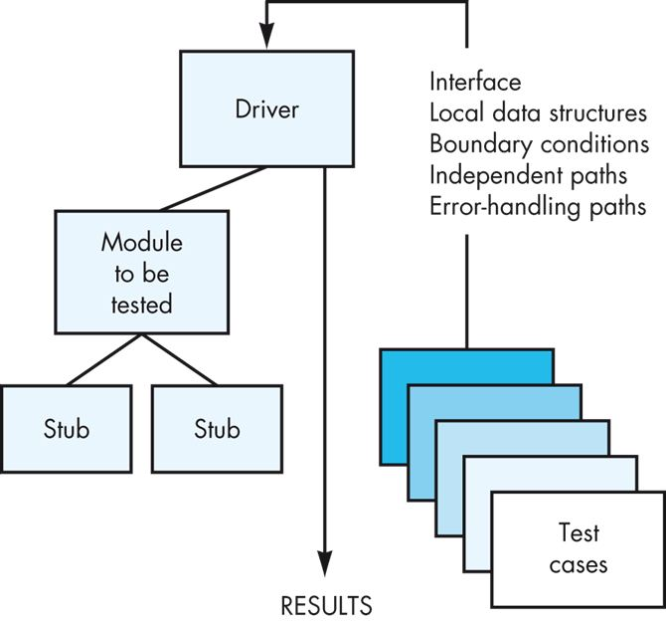
Unit Test Procedures
Because a component is not a stand-alone program, driver and/or stub software must often be developed for each unit test. In most cases, a driver is nothing more than a “main program” that accepts test-case data, passes this data to the component being tested, and records the results. Stubs (or dummies) serve to replace modules that are invoked by the component being tested. They replicate the other modules’ interfaces, may do minimal data manipulation,
record verification of entry, and return control to the component being tested.

Slide 32
Unit-testing Heuristics
1. Create unit tests as soon as object design is completed:
Black-box test: Test the use cases & functional model
White-box test: Test the dynamic model
Data-structure test: Test the object model
2. Develop the test cases
Goal: Find the minimal number of test cases to cover as many paths as possible
3. Cross-check the test cases to eliminate duplicates
Don't waste your time!
4. Desk check your source code
Reduces testing time
5. Create a test harness
Test drivers and test stubs are needed for integration testing
6. Describe the test oracle
Often the result of the first successfully executed test
7. Execute the test cases
Don’t forget regression testing
Re-execute test cases every time a change is made.
8. Compare the results of the test with the test oracle
Automate as much as possible

Slide 33
Your Turn
What is the concept of coverage in software defect testing?
What is the difference between statement coverage and path coverage?
Give an example where a set of test cases which achieve statement coverage fail to achieve path coverage.
What is a driver and what is a stub in unit testing?
Check-out the content of the following sites:
https://www.getzephyr.com/insights/developing-devops-testing-strategy-benefits-best-practices-tools
https://en.wikipedia.org/wiki/Unit_testing
https://martinfowler.com/bliki/UnitTest.html
https://stackify.com/unit-testing-basics-best-practices/
https://sites.google.com/site/swtestingconcepts/home/test-design-techniques/for-white-box/statement-branch-and-path-coverage

